Slide 1

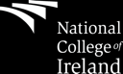
Object Oriented
Software Engineering
John Andrews

Slide 2
A programmer’s partner tells them:
"Go to the shop and get a loaf of bread. If they have eggs, get a dozen.”
The programmer returns with a dozen loaves of bread.

Slide 3
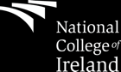
System Sequence Diagrams (SSDs)

Slide 4
What is a System Sequence Diagram?
A system sequence diagram (SSD) is a type of sequence diagram that shows, for a system the events that external actors generate, their order, and possible inter-system events.

Slide 5
Difference between Sequence Diagram
and System Sequence Diagram
The system sequence diagram is a specialised form of the sequence diagram, which depicts interaction between various actors and the system.
A system sequence diagram visualises a use case, while a sequence diagram visualises the interaction of multiple component objects or classes.

Slide 6
Modeling Behavior from a System Perspective
A Use Case Scenario is an ordered series of operations (functions) that Actors invoke on the System

Slide 7
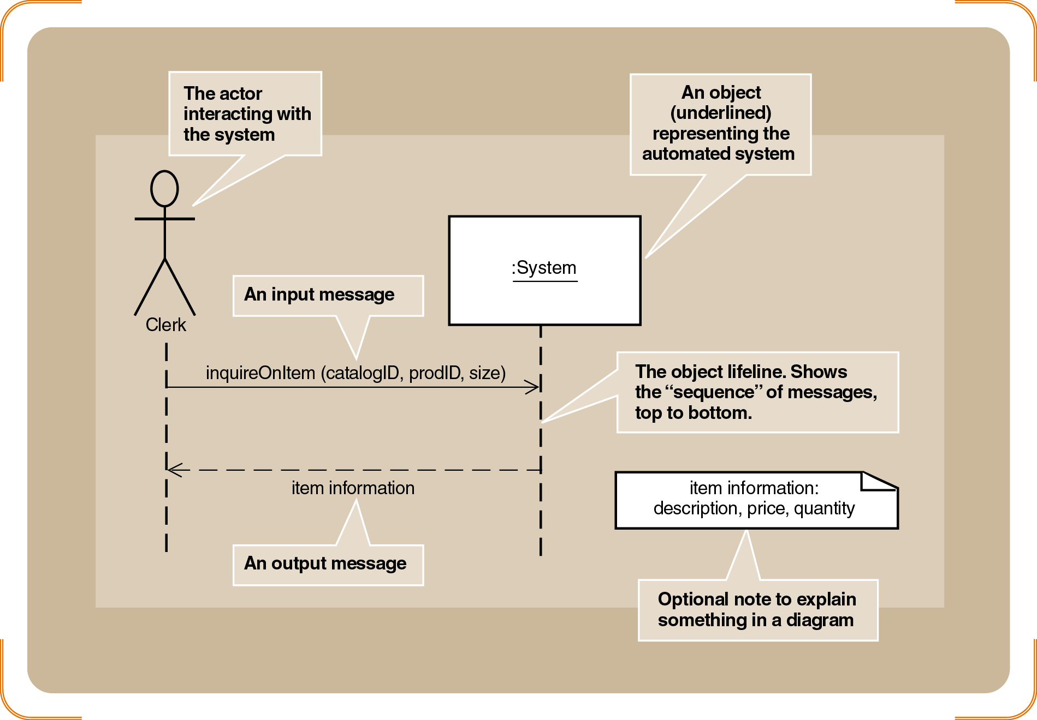
Sample System Sequence Diagram
Not a class

Slide 8
Why Draw a System Sequence Diagram (SSD)?
Software systems react to three things:
External input events (a.k.a., system events) from actors
Timer events
Faults or exceptions
SSD captures system behaviour: a description of what a system does, NOT how it does it
SSDs help transitioning towards design models from use-case models by clarifying details in use-cases

Slide 9

SSDs and System Behavior
System behaves as “Black Box”: interior objects are not shown, as they would be on a sequence diagram.
:System

Slide 10
System Sequence Diagram (SSD)
Special case for a sequence diagram
Only shows actor and one object
The one object represents the complete system
Shows input & output messaging requirements for a use case
Actor, :System, object lifeline
Messages

Slide 11
Benefits of a System Sequence Diagram
SSDs are ideal for demonstrating when and how tasks are completed in a system, especially as those tasks relate to use cases. Here are a few specific examples of when to use SSDs:
In a step-wise fashion, modelling operations of the system in response to events.
Building a blueprint for the main success scenario of a given use case, then creating alternative paths.
Identifying major system events and operations in order to produce realistic estimates of resources needed.
Source: https://www.lucidchart.com/pages/uml-system-sequence-diagram

Slide 12
SSD notation

Slide 13
SSD Notation
Actor: An Actor is modeled using the ubiquitous stick figure symbol
Object: is represented as a rectangle which contains the name of the object underlined
:Actor1
:System

Slide 14
SSD Notation (continued)
Lifeline: is depicted as a vertical dotted line extending from an object that identifies the existence of the object over time
Message: modeled as horizontal arrows between activations, indicate the communications between objects
messageName(argument)

Slide 15
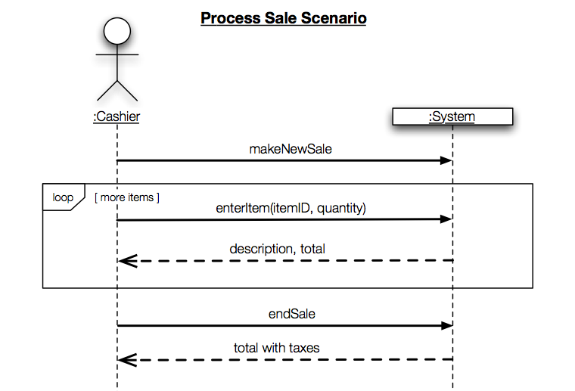
SSD Notation: An Example
External Actor
System as a Black Box
“:” implies instance
Interaction Frame
Message w/ Parameters
Guard
Return Values

Slide 16
Developing SSD
from use case

Slide 17
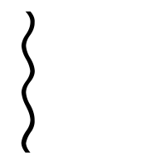
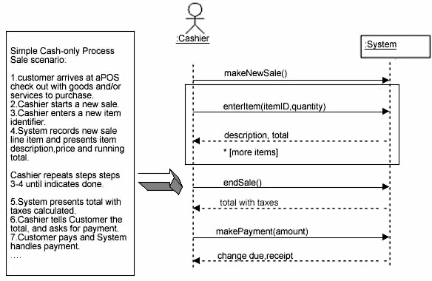
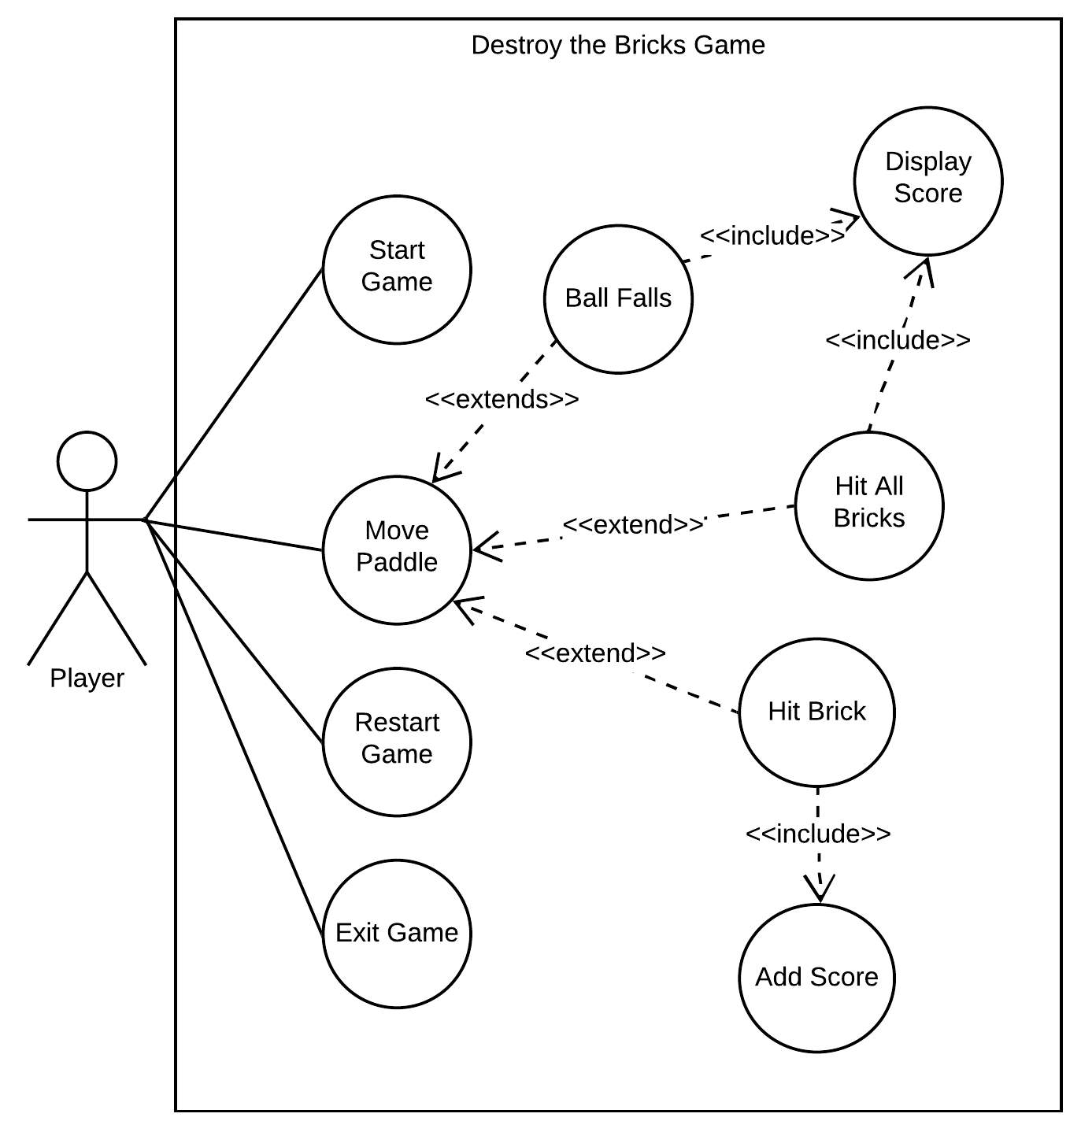
SSDs can be derived from use cases

Slide 18
Case Study: How to do SSD in for POS
Simple cash-only Process Sale scenario:
1. Customer arrives at a POS checkout with goods and/or services to purchase.
2. Cashier starts a new sale.
3. Cashier enters item identifier.
4. System records sale line item and presents item description, price, and running total.
Cashier repeats steps 3-4 until indicates done.
5. System presents total with taxes calculated.
6. Cashier tells Customer the total and asks for payment.
7. Customer pays and System handles payment.
...

Slide 19
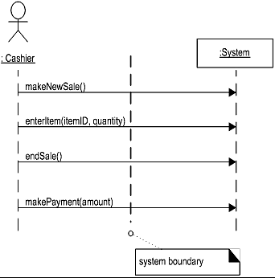
Step 1: Define System Events and the System Boundary
the system boundary is usually chosen to be the software system itself; in this context, a system event is an external event that directly stimulates the software

Slide 20
System Events and System Boundary
To identify the system events, knowing the system boundary is critical.
For the purpose of software development, the system boundary is chosen to be the software system itself.

Slide 21
Determining SSD System Boundary
Identifying the System events-
Determine the actors that directly interact with the system.
In the process Sale example, the customer does not directly interact with the POS system. Cashier interacts with the system directly. Therefore cashier is the generator of the system events.

Slide 22
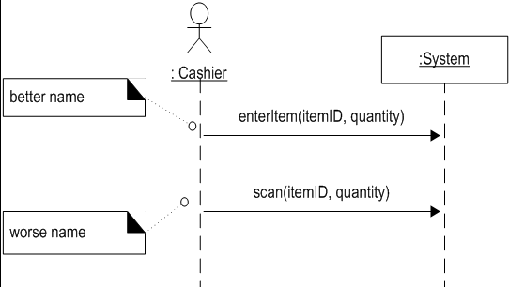
Step 2: Naming System Events and Operations

Slide 23
Step 3: Optionally Show Use Case
Simple cash-only Process Sale scenario:
1. Customer arrives at a POS checkout with goods and/or services to purchase.
2. Cashier starts a new sale.
3. Cashier enters item identifier.
4. System records sale line item and presents item description, price, and running total.
Cashier repeats steps 3-4 until indicates done.
5. System presents total with taxes calculated.
6. Cashier tells Customer the total, and asks for payment.
7. Customer pays and System handles payment.
...

Slide 24
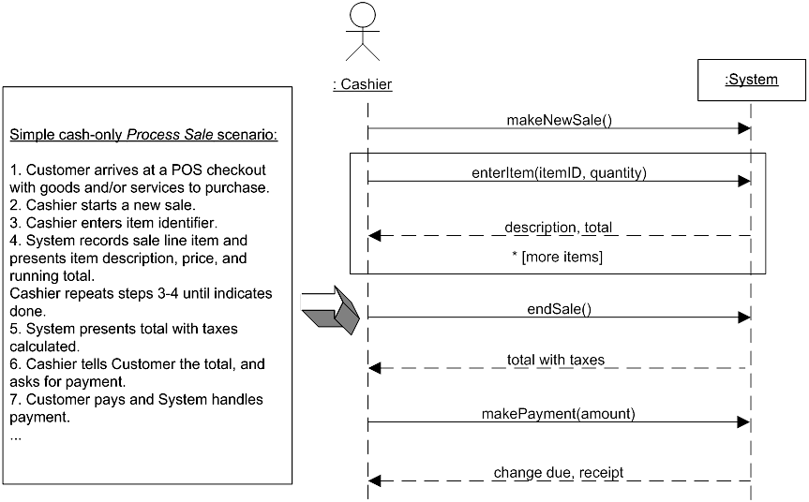
Step 4: Do SSD

Slide 25
Steps for Developing SSD
Identify input message
See use case flow of activities or activity diagram
Describe the message from the external actor to the system using the message notation
Name it verb-noun: what the system is asked to do
Consider parameters the system will need
Identify any special conditions on input messages
Iteration/loop frame
Opt or Alt frame
Identify and add output return values
On message itself: aValue:= getValue(valueID)
As explicit return on separate dashed line

Slide 26
SSD Message Examples with Loop Frame

Slide 27
SSD Message Examples Opt Frame (optional) Alt Frame (if-else)

Slide 28
Thank you!

